Slide 1

NORMAL DISTRIBUTION
SANTOSH CHHATKULI

Slide 2
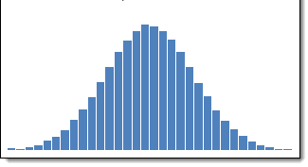
Introduction
A normal distribution is most important continuous probability distribution as most traditional statistical inferences are designed to work with data which follows a normal distribution.
It is the famous bell-shaped distribution
The distribution is frequently called the Gaussian distribution in recognition of contribution made by Carl Friedrich Gauss.
Many natural phenomena fits into a normal distribution such as height, IQ score etc.

Slide 3
Characteristics of Normal Distribution
The normal distribution possesses following important characteristics:
The curve is bell shaped.
The normal curve is symmetric around the mean. It implies that mean of a normally distributed population lies at the center of its curve i.e. at x = µ. The further a value is from the mean, the less likely it is to occur. Normal distribution is unimodal distribution i.e. it has only one mode.
Its measures of central tendency (mean, median and mode) are all equal.
Since y = f (x) being the probability can never be negative i.e. no portion of the curve lies below the X-axis.
The tails of normal curve are asymptotic, which means that they approach but never quite meet the horizon (i.e. X-axis)
The area under the normal curve represents probability and the total area under the normal curve above the X-axis is one square unit.

Slide 4
Importance of Normal Distribution
The distribution of many continuous variables such as height, weight, blood pressure etc. is approximately normal.
The measurement whose distribution is not normal, a simple transformation of the scale of measurements may induce normality. Hence the normal distribution can be used to solve the probability problem even in the skewed distribution.
An essential requirement for employing many statistical test such as t-test, ANOVA and tools such as regression, correlation and any other parametric analysis is that observations must have distribution not significantly different from normality. Thus, Normal Distribution serves as the foundation for classical statistical inference.
The normal distribution is relatively easier to work with mathematically.
We can use normal distribution to approximate various discrete probability distributions such as Poisson distribution, Binomial distribution and thereby avoid much computational drudgery.
Normal distribution is also used to find the normal values of biomedical measurements.
We can standardized the values (raw scores) of a normal distribution by converting them into z-scores.

Slide 5
Probability Density Function of ND
A continuous random variable X is said to follow normal probability distribution with mean µ and standard deviation σ if its density function is given by
Notations:
µ = mean of the population or location parameter
σ = standard deviation of the population or shape parameter
e = 2.7183, a base of the natural logarithm (constant)
π = 3.1416, a ratio of circumference to its diameter (constant)
f(x) = height or ordinate of the curve at the abscissa value x_{i}
The maximum ordinate occurs at the point x = µ and it is

Slide 6
Parameters of Normal Distribution
To define particular normal distribution, we need only two parameters-the population mean (µ) and population standard deviation (σ). In other words, a different normal distribution is specified for each different value of µ and σ.
The two normal distributions having same mean but different standard deviations have different shape of normal curve. The curve with large σ is lower at the mean and spreads wider and value of X that are far from the mean are more frequent.
Parameter µ is called location parameter and σ is called size parameter. The parameter σ determines the peakedness and flatness of the normal curve.

Slide 7
Area property of Normal Distribution
The empirical rule in statistics allows researchers to determine the proportion of values that fall within certain distances from the mean.
If the data values in a normal distribution are converted to Z-scores in a standard normal distribution the empirical rule describes the percentage of the data that fall within specific numbers of standard deviations (σ) from the mean (μ) for bell-shaped curves.
For any normally distributed population
68.26 % or roughly two-third of all the observations lie in the interval µ ± σ. Out of remaining 31.74 % or roughly one-third of observations, half i.e. 15.58 % or roughly one-sixth will lie below the lower limit µ - σ and other half i.e. 15.58 % will be above the upper limit µ + σ.
95.44 % of all the observations lie in the interval µ ± 2σ, while 4.56 % of observations will be outside the limits i.e. values differ from the mean by more than twice the standard deviation is being only 4.56 %.
The limits µ ± 3σ include 99.74 % of all observations. Chance of values being higher than µ + 3σ and the lower than µ - 3σ is very rare and it is only 0.26 %.

Slide 8
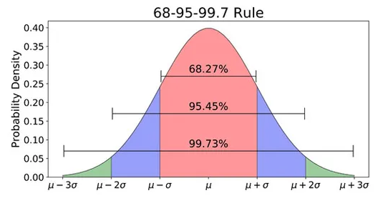

Slide 9
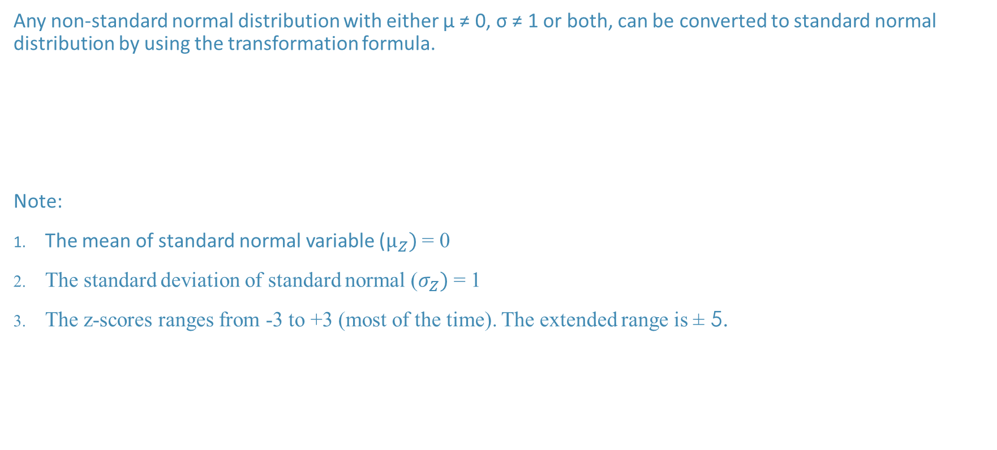
Standard Normal Distribution
Any non-standard normal distribution with either µ ≠ 0, σ ≠ 1 or both, can be converted to standard normal distribution by using the transformation formula.
Note:
The mean of standard normal variable ($µ_{Z})$ = 0
The standard deviation of standard normal ($σ_{Z})$ = 1
The z-scores ranges from -3 to +3 (most of the time). The extended range is ± 5.

Slide 10
How can I check if my data follows a normal distribution?
Graphical tools:
Histogram
Box-and-Whisker plot
P-P plot
Q-Q plot
Statistical test
Chi-square test of goodness of fit
Kolmogorov-Smirnov (KS) test
Lilliefors test
Shapiro Wilk test

Slide 11
Table of Standard Normal Distribution
In Normal Distribution we find three types of probability.
There are two principle tables.
Table of ordinate
Table of the cumulative distribution
Procedure for finding probabilities or percentage for given value of X
1. Sketch the normal curve, level the mean and specific x-values. Shade the region of desired probability.
Find the Z-score for each x-value at the boundary of this region.
Find the relevant area from table.

Slide 12
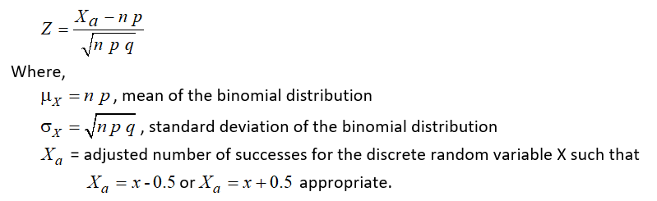
Normal Distribution as an approximation of Binomial Distribution
If n is large and if neither p nor q is too close to zero, the binomial distribution can be closely approximated by a normal distribution.
The normal approximation to a Binomial Distribution is very good if both np and nq are greater than 5.
To find the approximate probabilities corresponding to the values of the discrete random variable X, we have following standardized variable given by

Slide 13
Numerical:
Suppose a company launches an email marketing campaign to promote a new product. The marketing team sends out 5000 emails to potential customers, hoping to achieve a certain response rate. Based on past data and industry benchmarks, they estimate that the response rate for this campaign is 8%.
(a) Find mean and standard deviation
(b) Find the probability that there are in between 350 to 450 responses.
(Use normal approximation to binomial distribution)

Slide 14
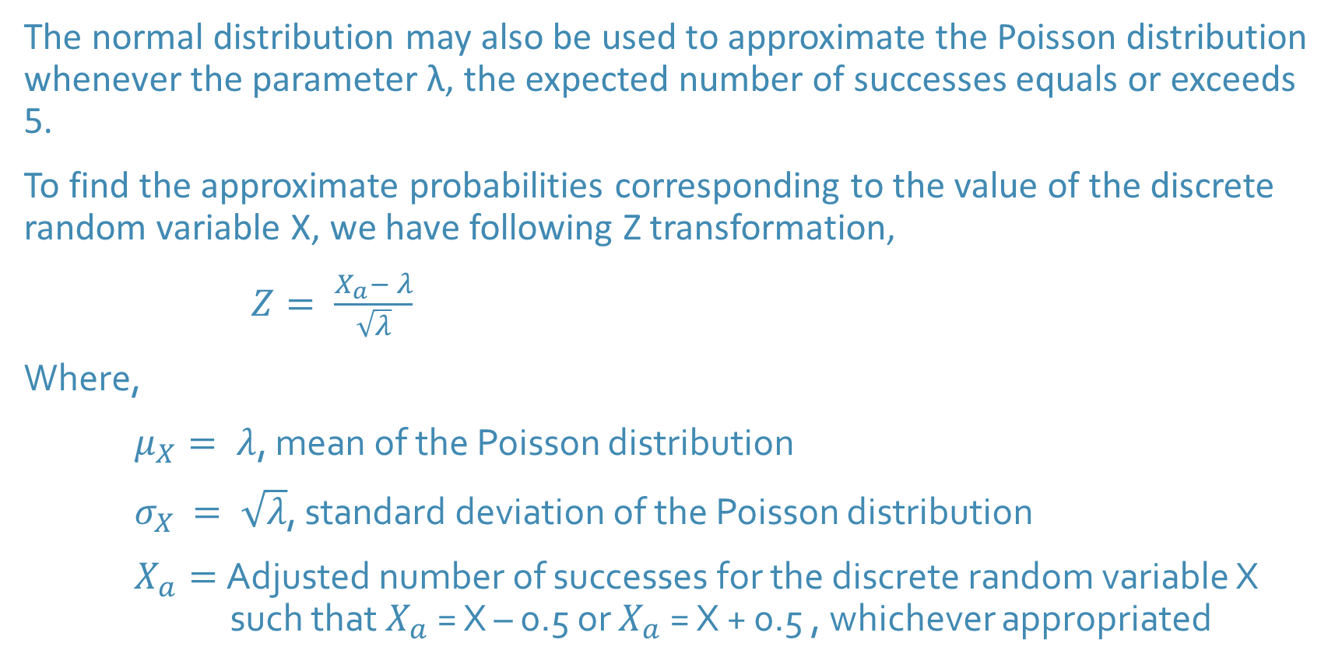
Normal Distribution as an approximation of Poisson Distribution
The normal distribution may also be used to approximate the Poisson distribution whenever the parameter λ, the expected number of successes equals or exceeds 5.
To find the approximate probabilities corresponding to the value of the discrete random variable X, we have following Z transformation,
$Z= \frac{X_{a}− λ}{\sqrt{λ}}$
Where,
$μ_{X}= λ$, mean of the Poisson distribution
$σ_{X }= \sqrt{λ}$, standard deviation of the Poisson distribution
$X_{a}=$Adjusted number of successes for the discrete random variable X such that $X_{a}$ = X – 0.5 or $X_{a}$ = X + 0.5 , whichever appropriated

